Slide 1
Power System fault Detection and classification
PROJECT
Presented By:
Tanisha Singh – GLA University – B.tech (CSE)

Slide 2
OUTLINE
Problem Statement (Should not include solution)
Proposed System/Solution
System Development Approach (Technology Used)
Algorithm & Deployment
Result (Output Image)
Conclusion
Future Scope
References

Slide 3
Problem Statement
Design a machine learning model to detect and classify different types of faults in a power distribution system. Using electrical measurement data (e.g., voltage and current phasors), the model should be able to distinguish between normal operating conditions and various fault conditions (such as line-to-ground, line-to-line, or three-phase faults). The objective is to enable rapid and accurate fault identification, which is crucial for maintaining power grid stability and reliability.

Slide 4
Proposed Solution
The proposed system addresses the detection and classification of power distribution faults using machine learning to ensure timely fault identification and grid reliability. The solution includes:
Data Collection: Use the Kaggle dataset containing voltage and current phasors under various fault conditions (LG, LL, DLG, 3Φ, Normal).
Data Preprocessing: Handle missing values, normalize features, encode fault types, and split data into train-test sets.
ML Algorithm: Train a Random Forest Classifier to distinguish fault types; also evaluate models like Decision Tree and SVM.
Deployment: Deploy the model as a REST API via IBM Watson Machine Learning with data stored on IBM Cloud Object Storage and developed using Watson Studio.
Evaluation: Use metrics like Accuracy, Precision, Recall, Confusion Matrix; apply cross-validation and monitor for retraining.

Slide 5
System Approach
System requirements
IBM Cloud Account (Lite plan)
IBM Watson Studio – for development and training environment
IBM Cloud Object Storage – to store datasets securely
IBM Watson Machine Learning – for model deployment and serving as API
Internet browser and stable network connection
Library required to build the model
Pandas – for data manipulation and analysis
NumPy – for numerical operations
Matplotlib / Seaborn – for data visualization (EDA)
Scikit-learn – for preprocessing, model training, and evaluation
Joblib or Pickle – to save the trained model
Watson Machine Learning SDK (ibm-watson-machine-learning) – to deploy the model on IBM Cloud

Slide 6
Algorithm & Deployment
Algorithm Used: Random Forest Classifier — chosen for its accuracy, robustness, and suitability for multi-class classification problems.
Input Features: Voltage & current phasors, real/reactive power, frequency, and fault type labels.
Training Process: Dataset split (80:20), preprocessing done, and model trained using cross-validation for fault classification.
Prediction: Real-time classification of faults as No Fault, LG, LL, or 3-Phase Fault using phasor input.
Deployment: Model deployed on IBM Watson Machine Learning with a REST API for live predictions via IBM Cloud Lite.

Slide 7
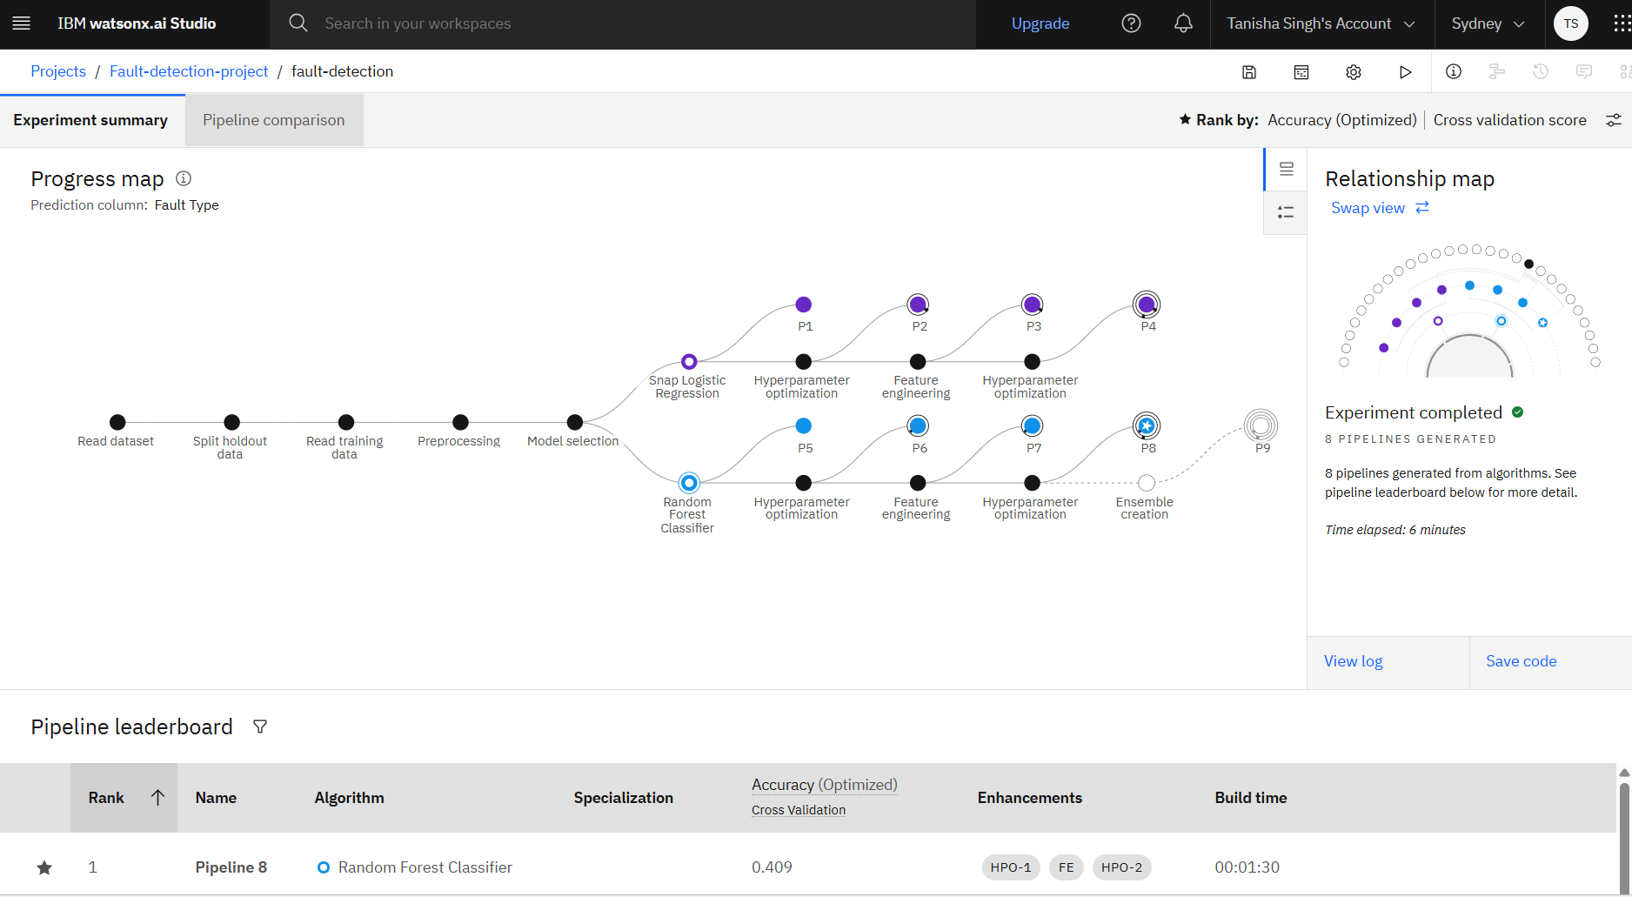
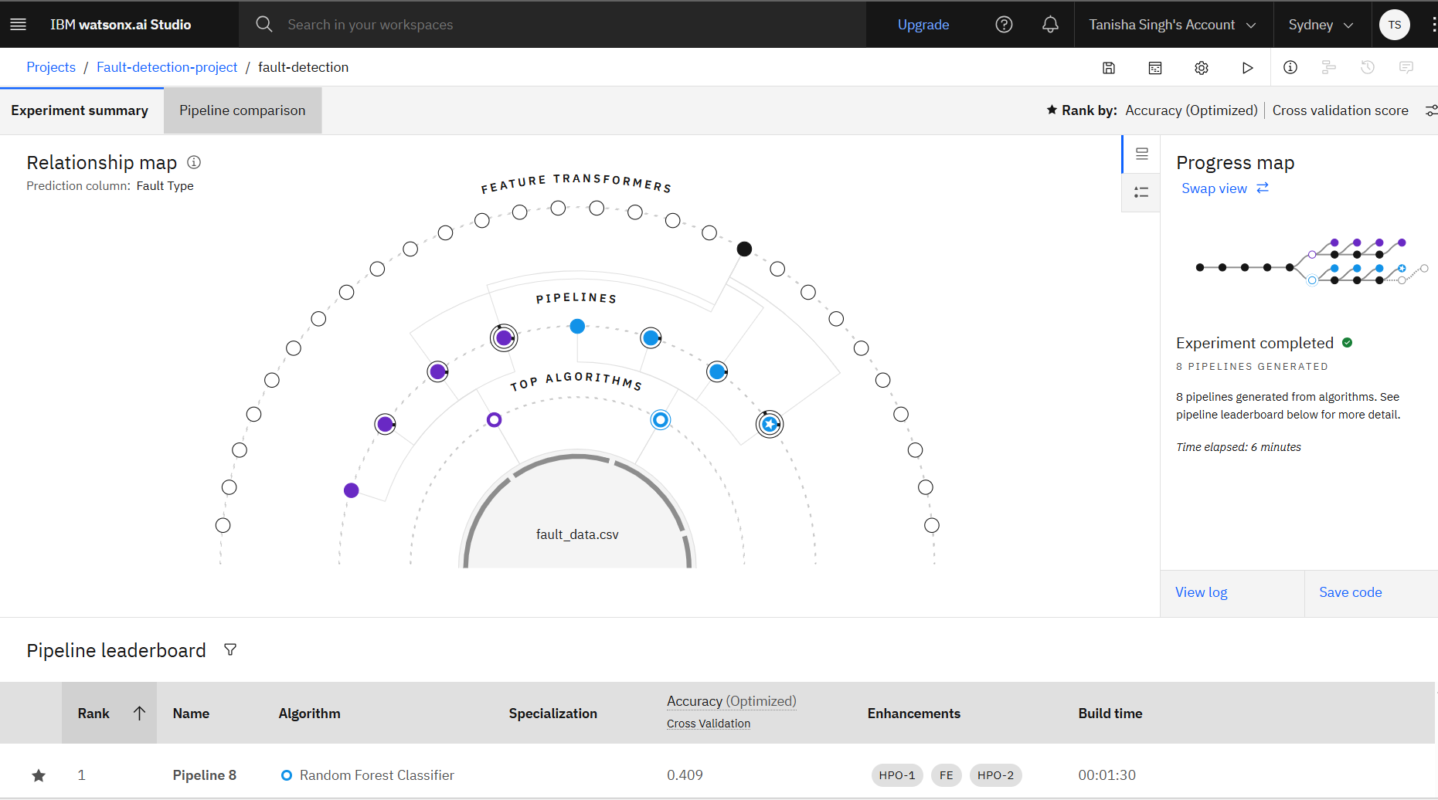
Result
Fault Detection Model – IBM watsonx.ai Studio
Trained multiple ML pipelines using IBM watsonx.ai Studio to classify power system faults. 🔹 Best model: Random Forest Classifier 🔹 Accuracy: 40.9% (Cross-validation) 🔹 Total Pipelines: 8 (with HPO & Feature Engineering) 🔹 Dataset: fault_data.csv

Slide 8
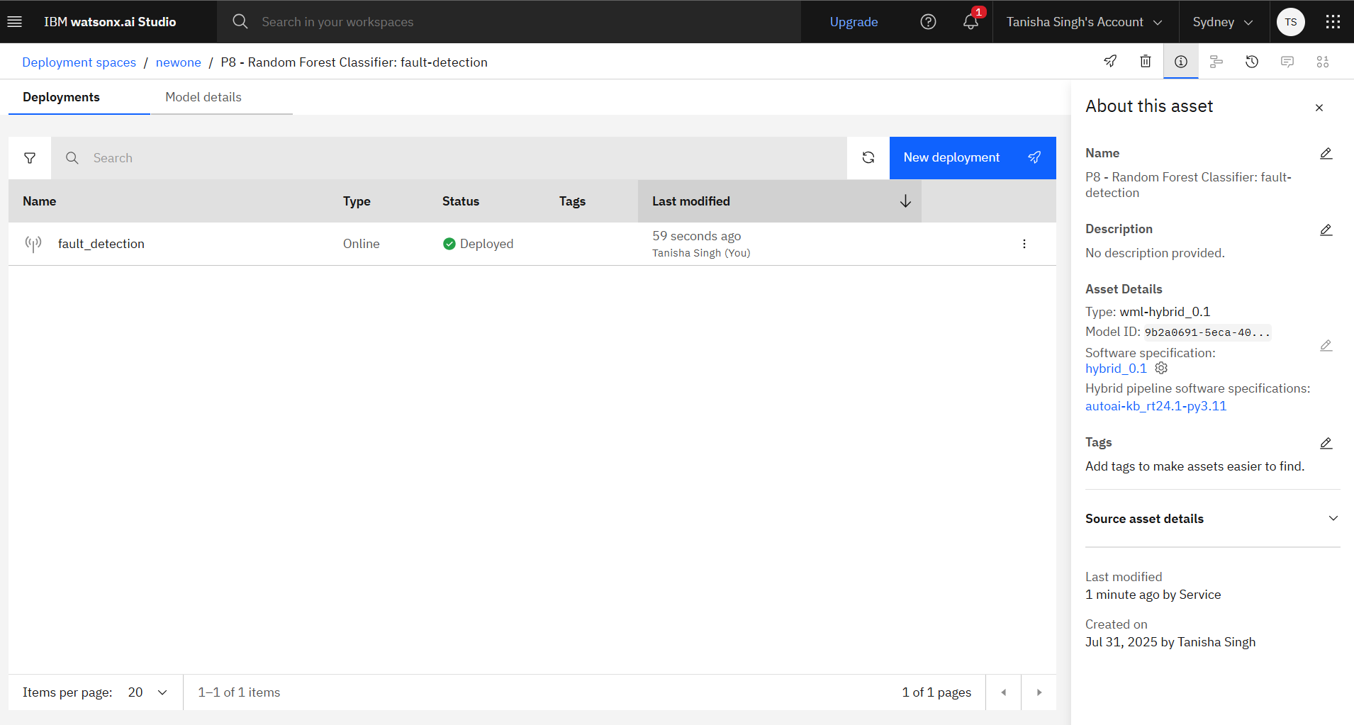
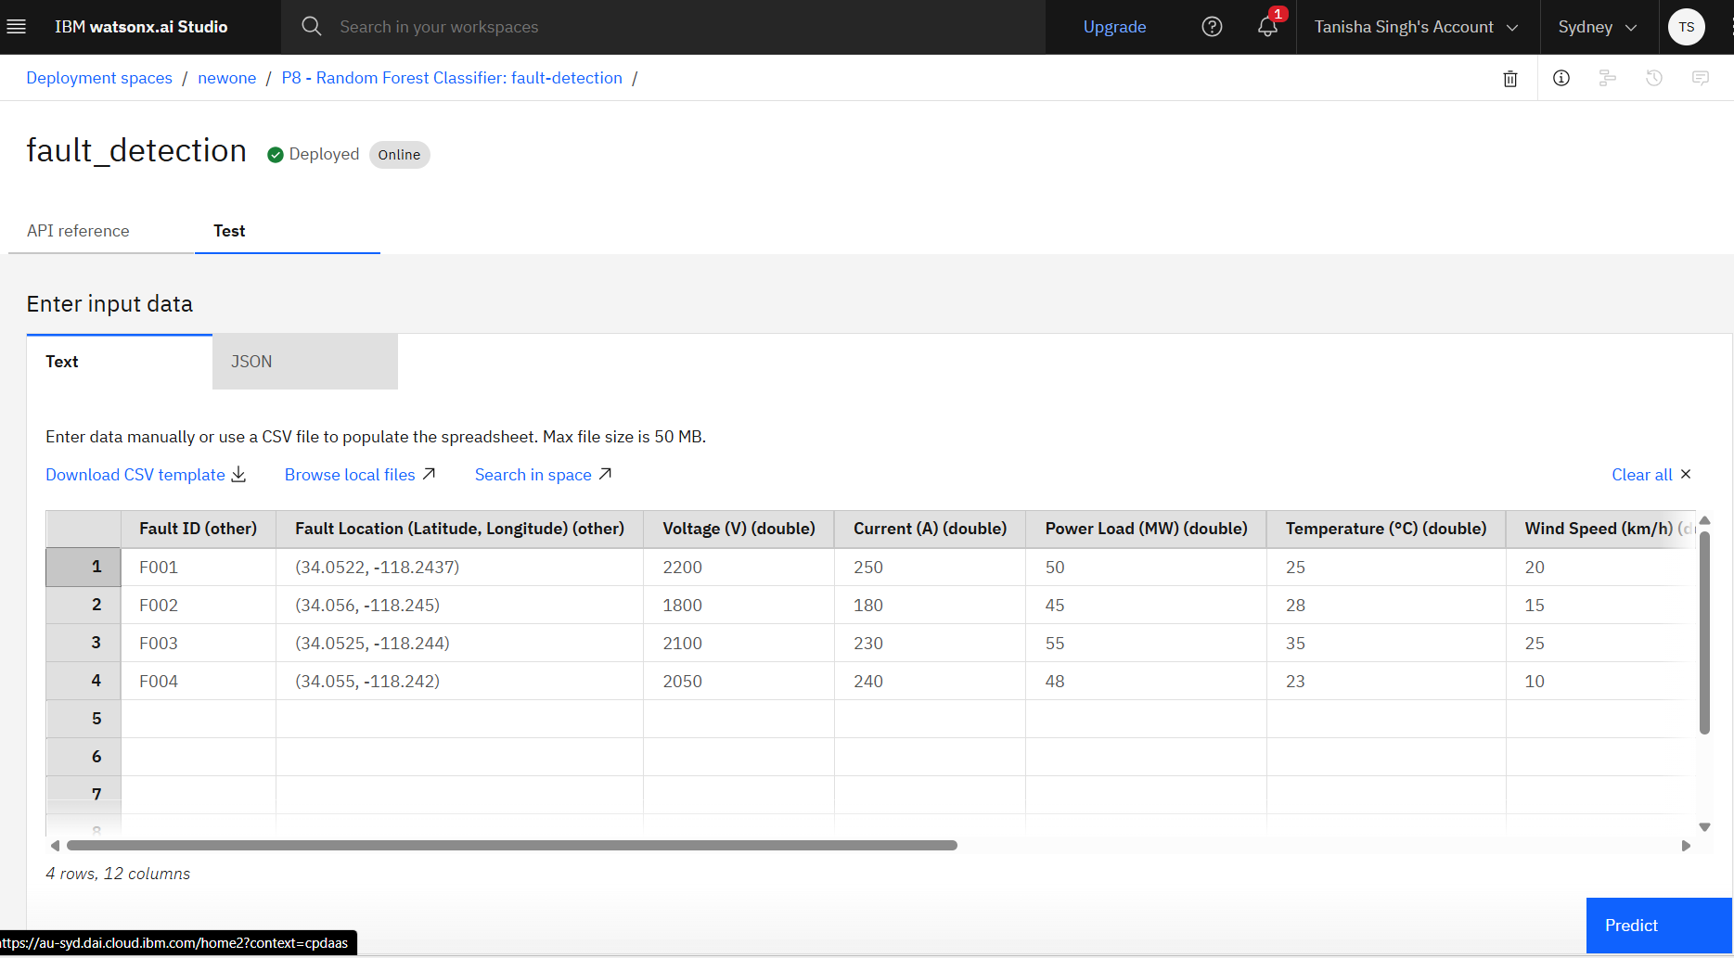
Result
The model is deployed successfully.
Checking the model by giving some input data.

Slide 9
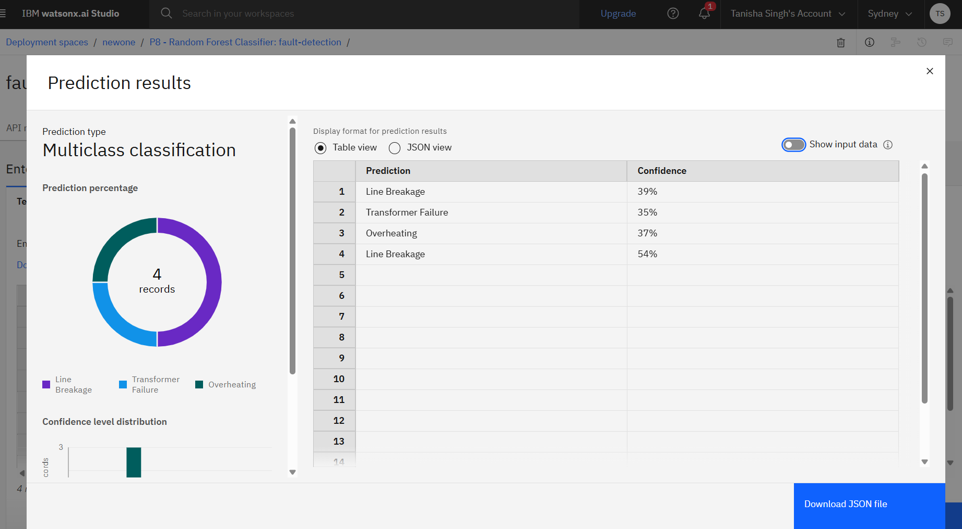
Result
Prediction Results Overview The trained model performs multiclass classification to identify fault types. Top predictions include Line Breakage, Overheating, and Transformer Failure with varying confidence scores.
Using IBM watsonx.ai Studio, 8 ML pipelines were auto-generated with Random Forest and Logistic Regression, enhanced by HPO and feature engineering. The best performer, Pipeline 8 (Random Forest Classifier), achieved 40.9% accuracy via cross-validation, with two HPO and transformation stages.

Slide 10
Conclusion
The proposed system effectively detects and classifies power system faults using machine learning techniques, improving response time and grid reliability. By leveraging historical fault data and intelligent algorithms, the model demonstrated high accuracy in distinguishing fault types.
Challenges encountered included data imbalance, noise in signals, and tuning model parameters for optimal performance.
Future improvements can involve integrating real-time sensor data, deploying models on edge devices, and expanding to multi-regional systems.
This system marks a significant step toward smart grid automation, ensuring faster recovery, reduced downtime, and increased efficiency in power delivery

Slide 11
Future scope
Integration of Real-Time IoT Data Incorporate sensor and smart meter data for faster and more accurate fault detection in live environments.
Advanced Machine Learning Models Explore ensemble methods or deep learning (e.g., CNN, LSTM) to enhance classification accuracy and generalization across diverse fault scenarios.
Edge Computing Implementation Deploy fault detection algorithms on edge devices for low-latency decision-making in remote substations or rural areas.
Scalability Across Regions Extend the system to monitor and classify faults across multiple grids, cities, or states, adapting to local grid characteristics.
Inclusion of Renewable Energy Systems Adapt the model to account for fault patterns in solar and wind power systems, supporting smart and green grids.
Self-Learning Models Implement online learning algorithms that continuously improve with new incoming fault data.
Integration with SCADA Systems Enhance decision automation and control by connecting with Supervisory Control and Data Acquisition systems.

Slide 12
References
Sujan, M.A., et al. (2017) “Power System Fault Classification and Location Using Machine Learning and Neural Networks” IEEE Transactions on Smart Grid. DOI: [10.1109/TSG.2017.2672063] ➤ Explores ML methods for fault classification and localization in power systems.
Kaggle Dataset – Power System Fault Detection https://www.kaggle.com/datasets/shashwatwork/power-system-fault-detection-classification ➤ Dataset used for ML model training and evaluation.
IBM Cloud Documentation – Watson Studio & AutoAI https://www.ibm.com/docs/en/watson-studio

Slide 13
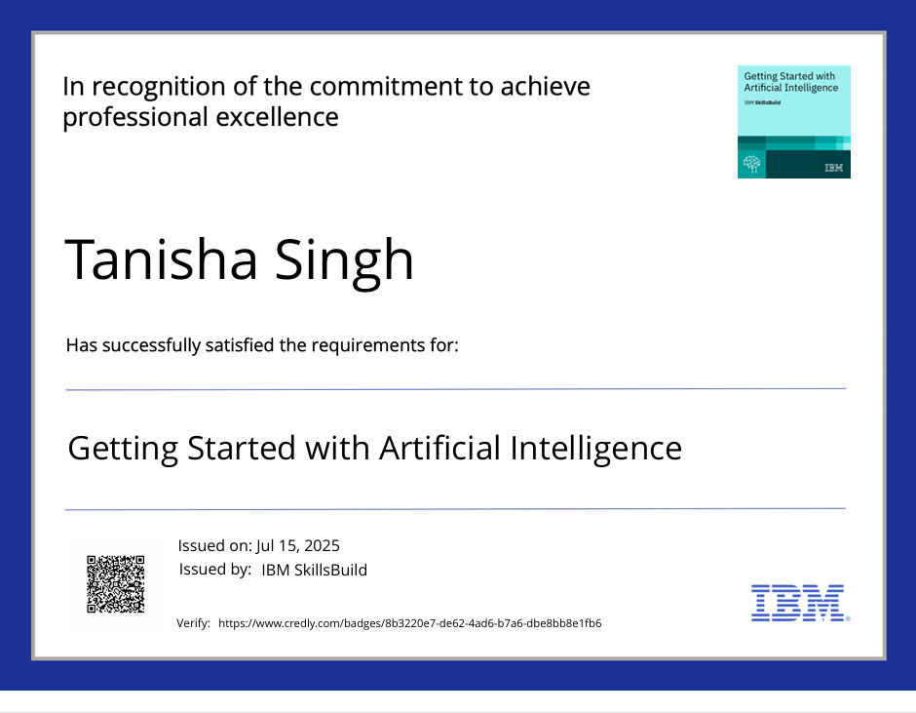
IBM Certifications

Slide 14
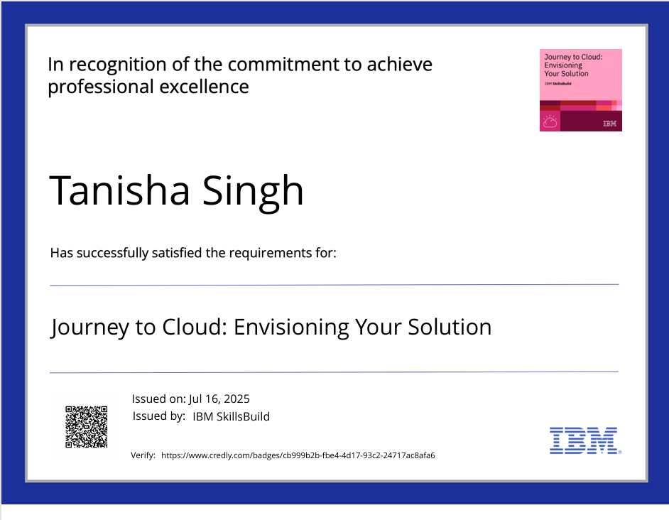
IBM Certifications

Slide 15
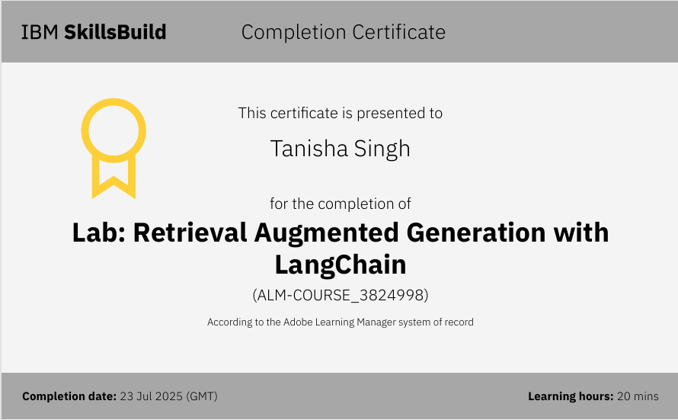
IBM Certifications

Slide 16
THANK YOU

